Slide 1

Easy Move OMS (Order Management System)
C#.NET Project
By Roman Shaiko, Dmitrii Kudrik

Slide 2
Problems to be solved
Ordering
Generating documents
Scheduling
Track payments
Add some intelligence

Slide 3
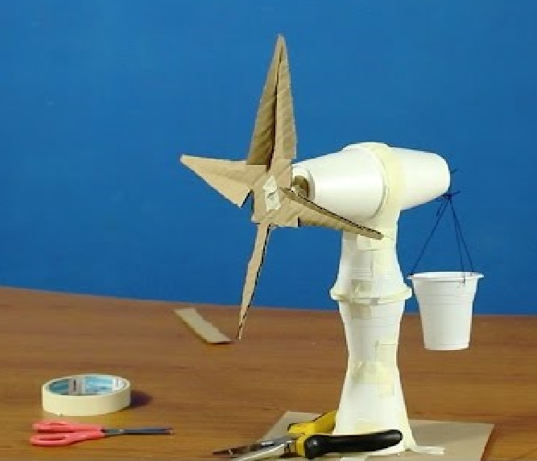



Usual School Project
Real World Project
the objective - x
the objective - x
the requirements - x
the requirements - 2x
responsibility - x
responsibility - 2x
detailing - x
detailing - 3x
communication - x
communication - 2x
stress - x
stress - 2x
tools - x
tools - x
messages - x
messages - 2x
8 x
16 x
x
50+ x

Slide 4
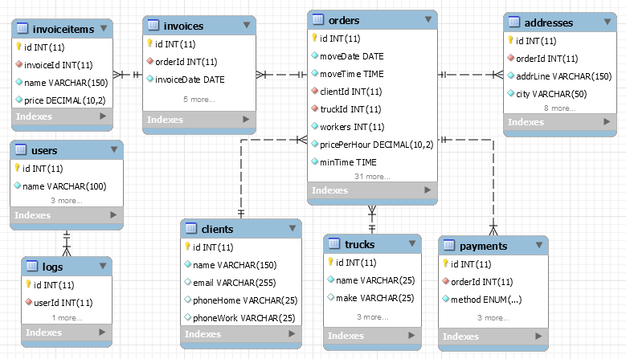
Database structure

Slide 5
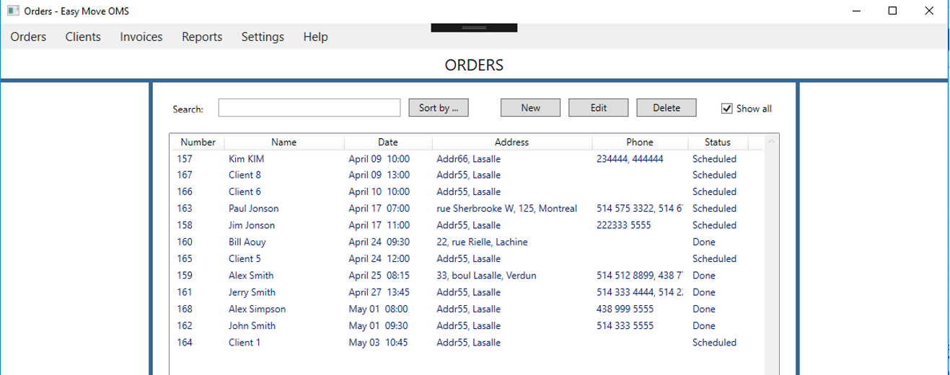
Main Window

Slide 6
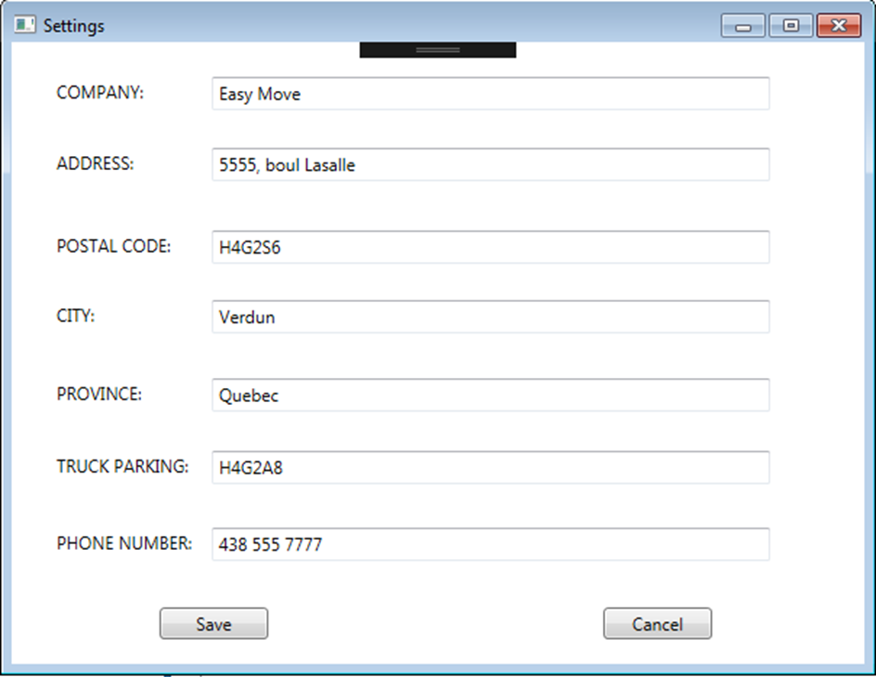
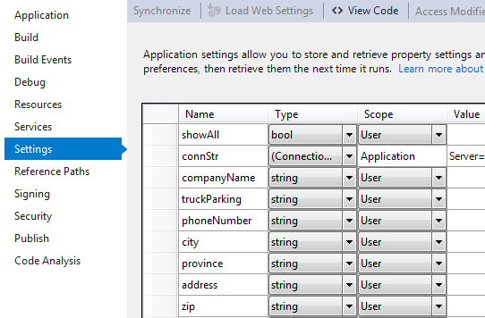
Application/User Settings

Slide 7
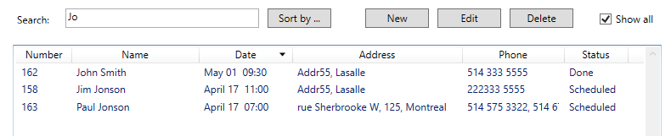
Main Window Search and Sorting

Slide 8
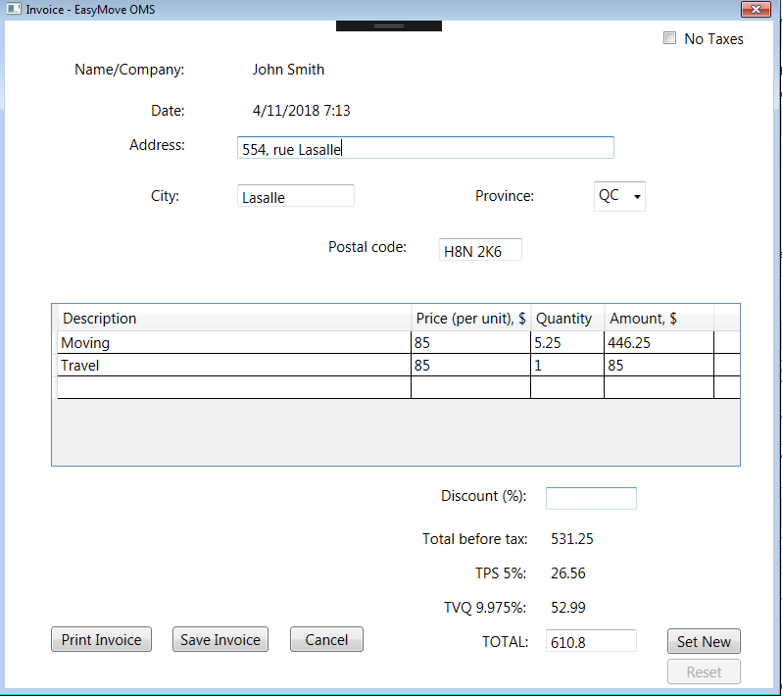
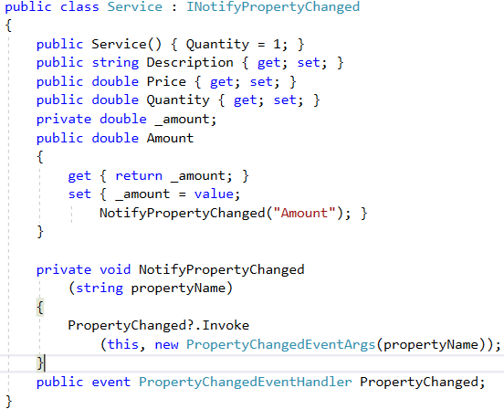
Invoice Window

Slide 9
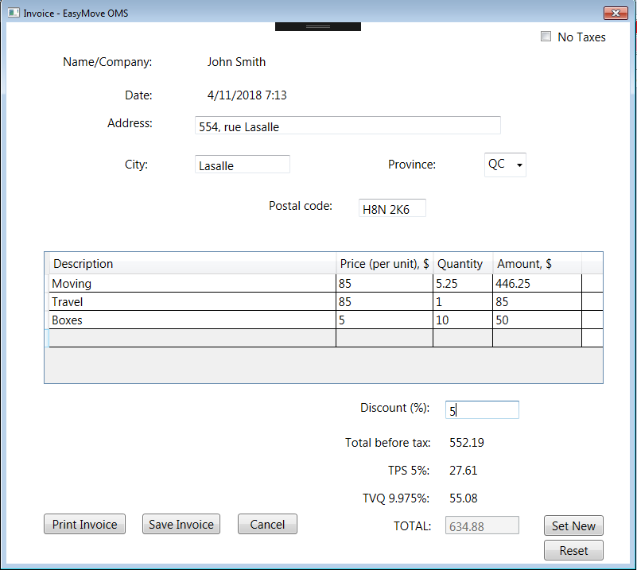
Adding items to invoice and setting the discount

Slide 10
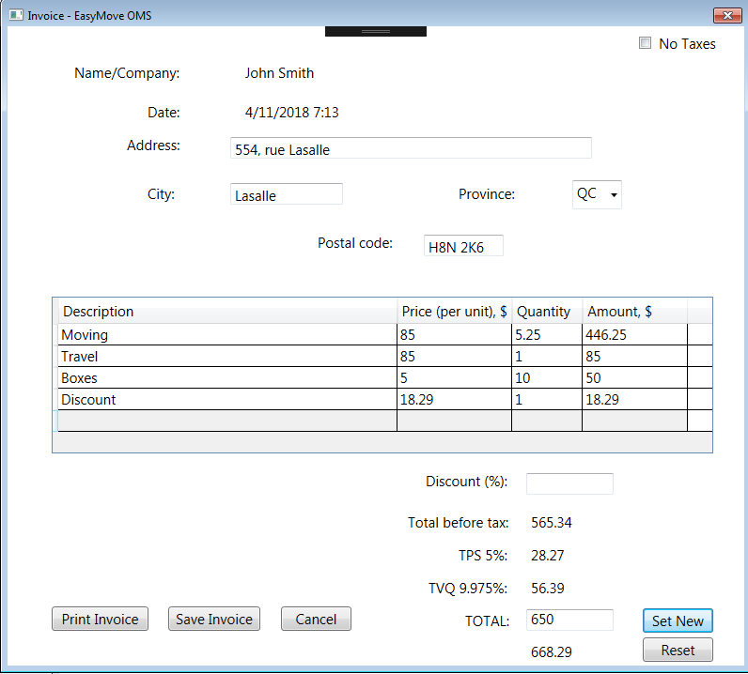
Adding discount/ expense to the table as a new row

Slide 11
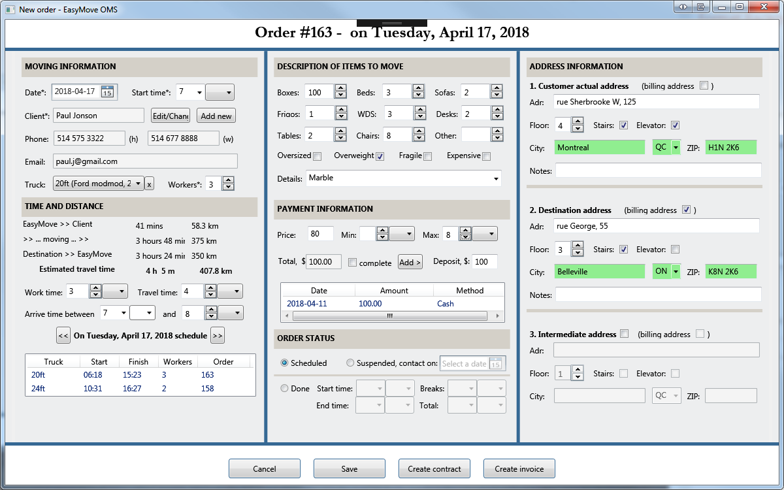
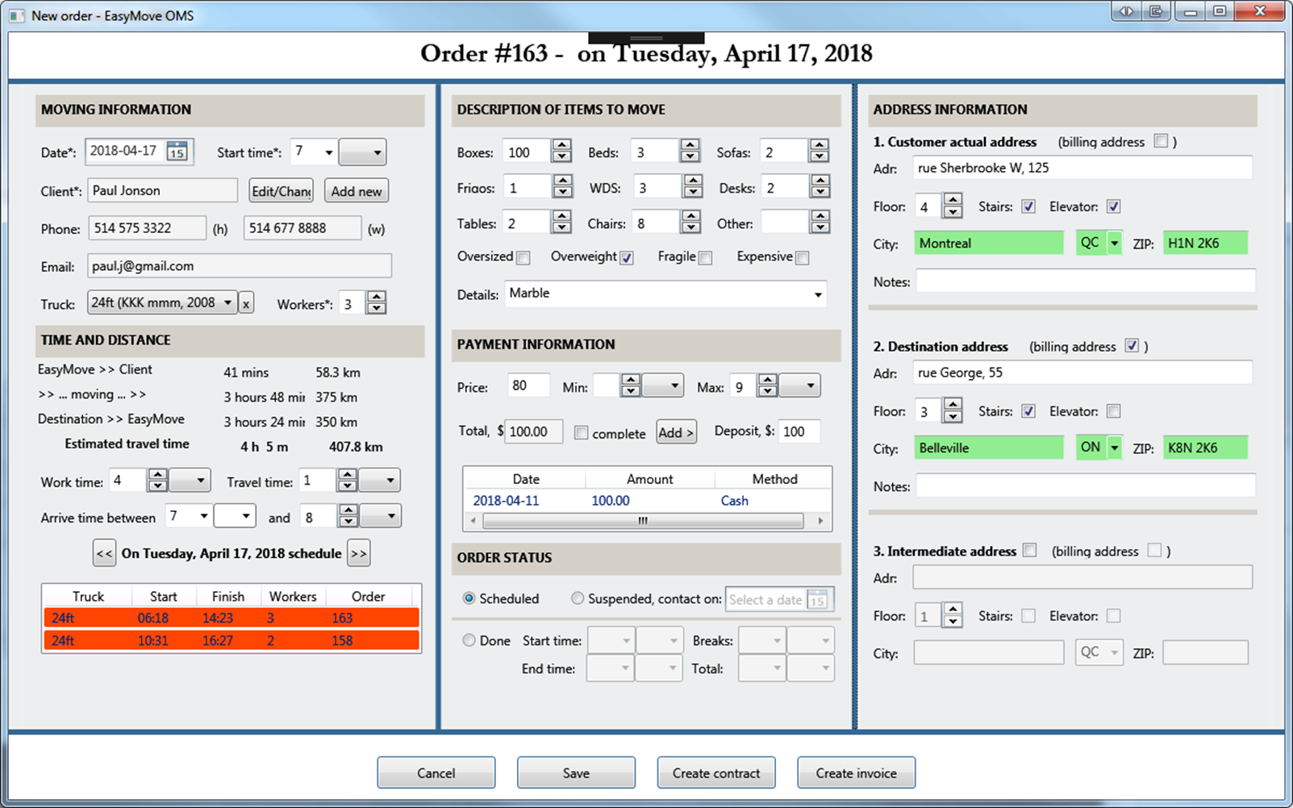

Slide 12
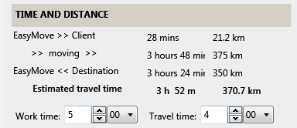
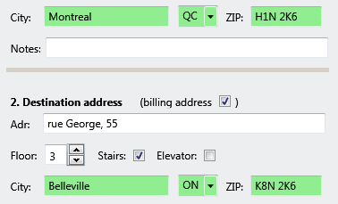
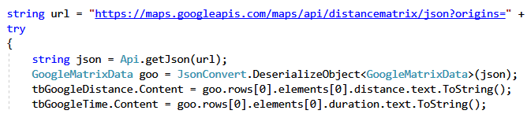
Google Matrix API

Slide 13
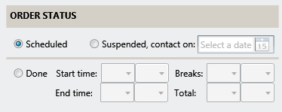
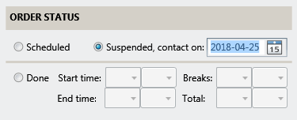
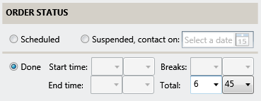
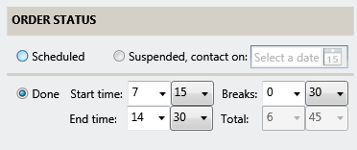
Order status

Slide 14
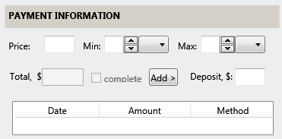
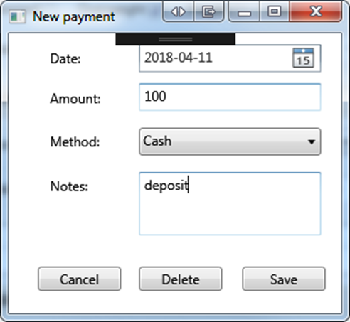
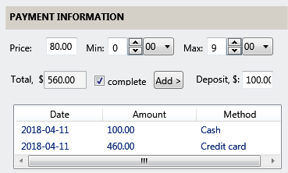
Payment information

Slide 15
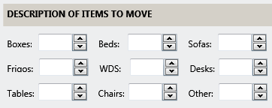
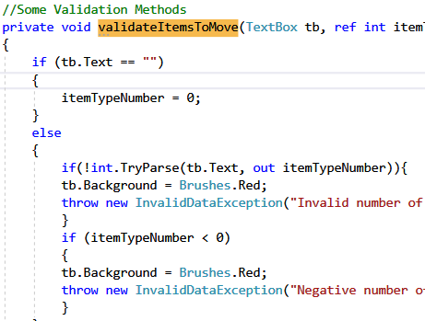
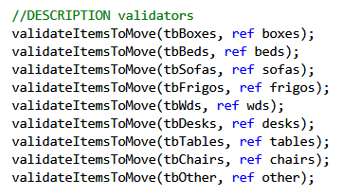
Validation by references

Slide 16
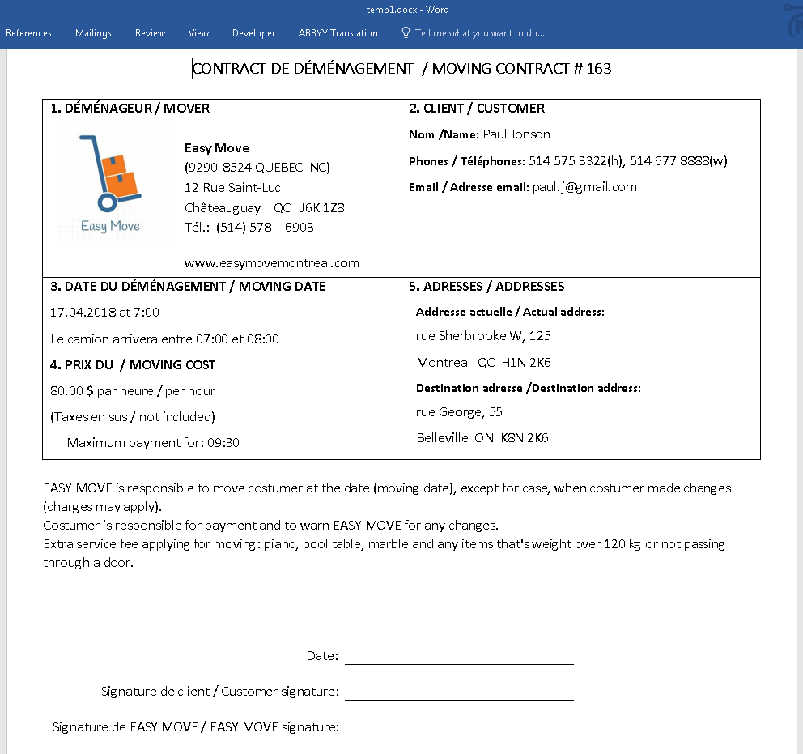

Slide 17
Further development of the project could include : ​
Sending invoices as emails using Google API
Creating monthly schedule of the trucks
Generating monthly/quarterly reports

Slide 18
The Easy Move OMS application allows the users to manage the data of a moving company
Orders can be created and edited
Invoices can be generated and printed
Daily schedule of the trucks is generated

